Slide 1
Openstack, Cloud Computing
A brief Introduction
By -
Sanjay Upadhyay
twitter - @saneax
mail - saneax@gmail.com

Slide 2

Who am I?
Passionate about technology
Sys Admin, Devops
15 Years of experience
Working with RJIL, Building the cloud for Reliance Jio
Worked with Yahoo! for 6 years

Slide 3
What is Cloud
While its easier to say, its difficult to describe.
A visible mass of condensed watery vapour floating in the atmosphere, typically high above the general level of the ground.
visible mass = url
condensed watery vapour = Service/Application
floating = Highly available
atmosphere = virtual
High above the ground = distant (not local)

Slide 4
Visible mass = URL
The Start
Web started with Tim Berners Lee in the year 1989
A big part of it drove a new paradigm called ‘search’
Then Social
Then online retail
next is anyones guess

Slide 5
Tale of 3 successes
Yahoo! (Jeyrr Yang and David Filo) search was born in 1995
Google (Larry Page and Sergey Bin) was born in 1997
Amazon (Jeff Bezos) was born in 1995, but after many failures succeeded around the year 2000.

Slide 6
For all the success what is the Highest driving Cost factor ???
DATACENTER

Slide 7
Atmosphere = Virtual
History of Virtualization
Bochs born in 1999 by kevin lawton (http://bochs.sourceforge.net)
Qemu born in 2005 by Fabrice Bellard (http://wiki.qemu.org/Main_Page)
VMWare was born in 1999, with vmware workstation, then vmware server in 2001, VMWare GSX was launched in 2004 and the same year EMC acquired it. VMware ESX was defacto virtualized datacenter as a service (IAAS)
Xen released in 2003 and gained acceptance in 2005 is a para virtualized virtualization
KVM (Kernel based virtual machine) was born out of QEMU in 2007
Notes:
Xen came out of The University of Cambridge Computer Laboratory
http://www.xenproject.org/

Slide 8
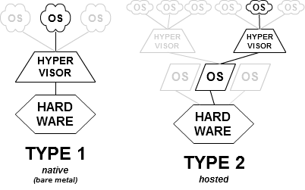
Hypervisor types

Slide 9
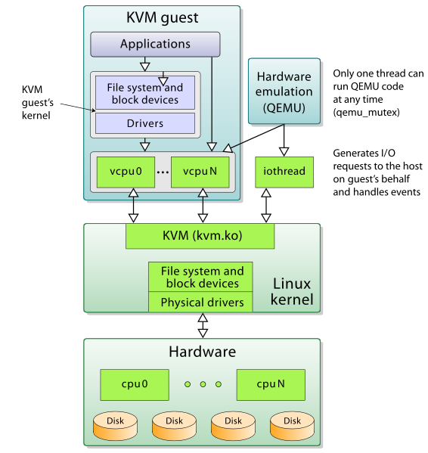
KVM Architecture

Slide 10
Why Virtualize?
Resource Optimization
consolidation
Maximizing Uptime
Automatically Protect Applications from hardware failure
Save Power
Rapid prototyping

Slide 11
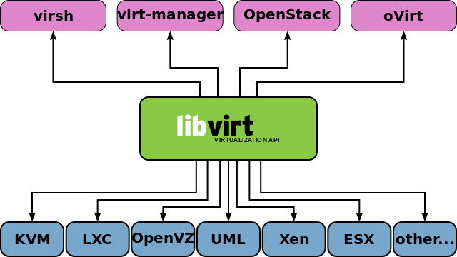
Libvirt (enter the dragon)
Notes:
A toolkit to interact with the virtualization capabilities of recent versions of Linux (and other OSes), see our project goals for details.
Remote management using TLS encryption and x509 certificates
Remote management authenticating with Kerberos and SASL
Local access control using PolicyKit
Zero-conf discovery using Avahi multicast-DNS
Management of virtual machines, virtual networks and storage
Portable client API for Linux, Solaris and Windows

Slide 12
Joining the Dots
The Problem
Datacenter
The Solution
libvirt?
High above the ground = distant (not local)
floating = Highly available
condensed watery vapour = Service/Application

Slide 13
History of Openstack
Two Different companies were solving Two different problems.
Nasa - Compute
Rackspace - Storage
Swift was born out of storage
Nova was born out of Compute (year 2010)

Slide 14
Thus, IAAS Was born
Join Swift and Nova Together and we have a solution for datacenter, conveniently called IAAS
( Infrastructure as a service )
Notes:
Shirtly discuss on AWS model, and its unanticipated success.

Slide 15
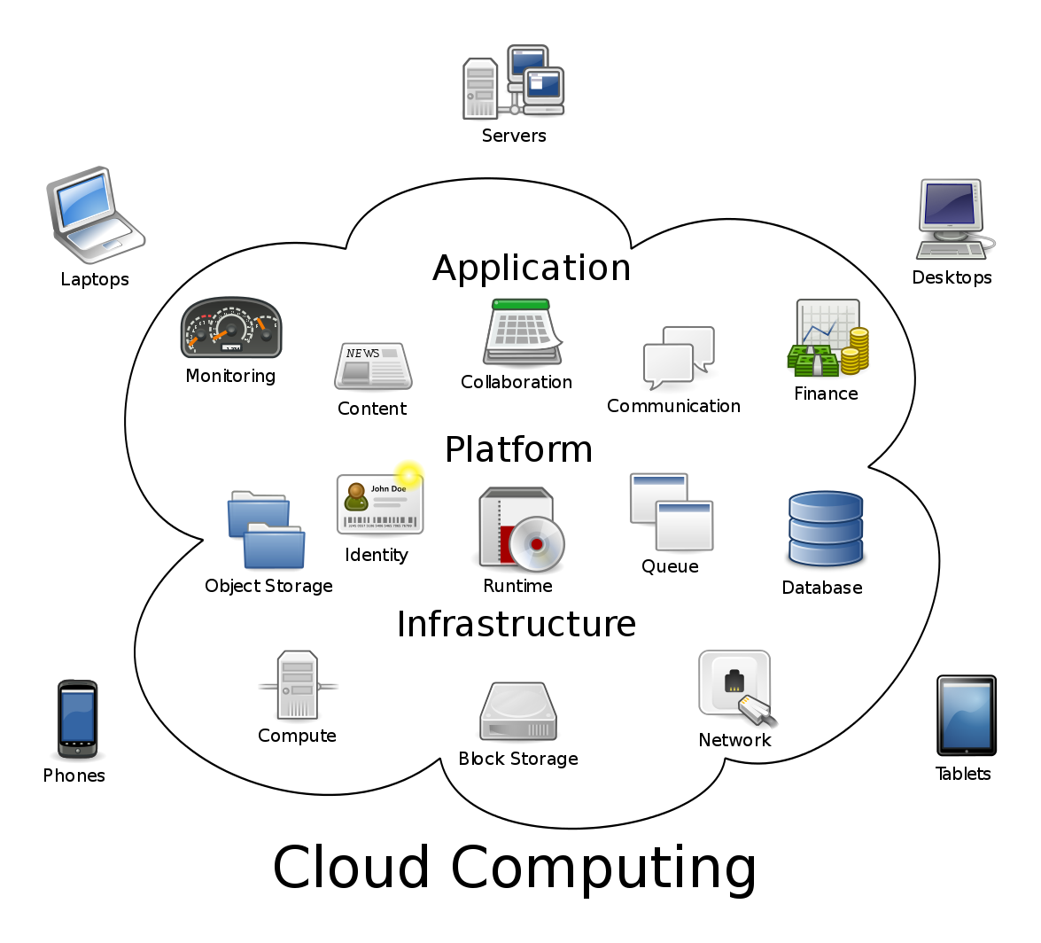
Now

Slide 16
Openstack Components
Nova (compute)
Swift (storage, object)
Cinder (block storage)
Neutron (networking)
Keystone (identity services)
Glance (image services)
Horizon (dashboard)
Ceilometer (telemetry)
Heat (Orchestration)
Trove (database)
Ironic (bare metal provisioning)
Sahara (elastic MR)

Slide 17
Nova
OpenStack Compute (Nova) is a cloud computing fabric controller
KVM, VMware, and Xen are available choices for hypervisor technology
Exposes RESTful API

Slide 18
Swift
OpenStack Object Storage (Swift) is a scalable redundant storage system.
Objects and files are written to multiple disk drives spread throughout servers in the data center
Storage clusters scale horizontally simply by adding new servers.
inexpensive commodity hard drives and servers can be used.

Slide 19
Cinder
OpenStack Block Storage (Cinder) provides persistent block-level storage devices for use with OpenStack compute instances.
The block storage system manages the creation, attaching and detaching of the block devices to servers.
Block storage volumes are fully integrated into OpenStack Compute and the Dashboard allowing for cloud users to manage their own storage needs.

Slide 20
Neutron
OpenStack Networking (Neutron, formerly Quantum) is a system for managing networks and IP addresses.
OpenStack Networking ensures the network is not a bottleneck or limiting factor in a cloud deployment, and gives users self-service ability, even over network configurations.
Users can create their own networks, control traffic, and connect servers and devices to one or more networks.

Slide 21
keystone
OpenStack Identity (Keystone) provides a central directory of users mapped to the OpenStack services they can access.
It acts as a common authentication system across the cloud operating system and can integrate with existing backend directory services like LDAP.
It supports multiple forms of authentication including standard username and password credentials, token-based systems and AWS-style (i.e. Amazon Web Services) logins

Slide 22
Glance
OpenStack Image Service (Glance) provides discovery, registration, and delivery services for disk and server images.
Stored images can be used as a template. It can also be used to store and catalog an unlimited number of backups.
The Image Service can store disk and server images in a variety of back-ends

Slide 23
Horizon
OpenStack Dashboard (Horizon) provides administrators and users a graphical interface to access, provision, and automate cloud-based resources.
The design accommodates third party products and services, such as billing, monitoring, and additional management tools.

Slide 24
Ceilometer
OpenStack Telemetry Service (Ceilometer) provides a Single Point Of Contact for billing systems, providing all the counters they need to establish customer billing, across all current and future OpenStack components.

